Slide 1
Digital Image Processing
Color Image Enhancement Using Multiscale Retinex with Modified Color Restoration Technique
Under the Guidance of: Dr. Rajib Kumar Jha
Submited by:
Name:- 1. Santan suman (2011MT17)
2. Shubham Wasnik (2011MT18)

Slide 2
Introduction
Color image enhancement plays an important role in Digital Image Processing.
The purpose of image enhancement is to get finer details of an image and highlight the useful information. If a person acquires an image by using a digital camera or mobile, the illumination such as fluorescent lamp in a room or sunlight in an open air is apt to be uneven and uncontrolled. As a result, the image degrades leaving excessively dark or brighter regions in an image.
Many image enhancement methods were proposed to enhance images degraded by irregular illumination: intensity transformation, histogram modeling, homomorphic filtering and Retinex . Human vision system is able to adapt to the changes of lighting conditions but machine vision cannot adapt itself to the color changes. Therefore, discrepancies often exist between direct observation of scenes and recorded color images.
Multiscale Retinex with color restoration effectively enhances the images which is degraded by irregular illumination.

Slide 3
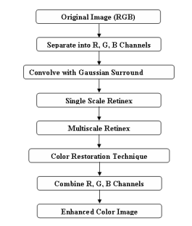
Steps Followed:-

Slide 4




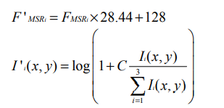
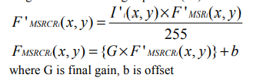
Formula Used:-
Gaussian Surround Function F(x, y):
Single Scale Retinex :
Multi Scale Retinex : ; Wn =1/3
color restoration techique :
; C=125
; G=2.25, b=-30

Slide 5
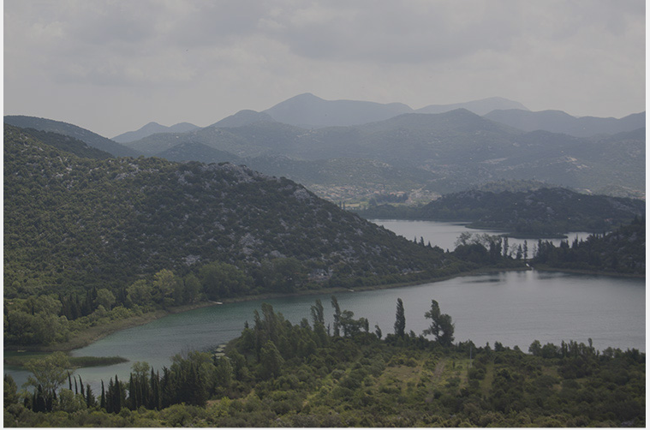
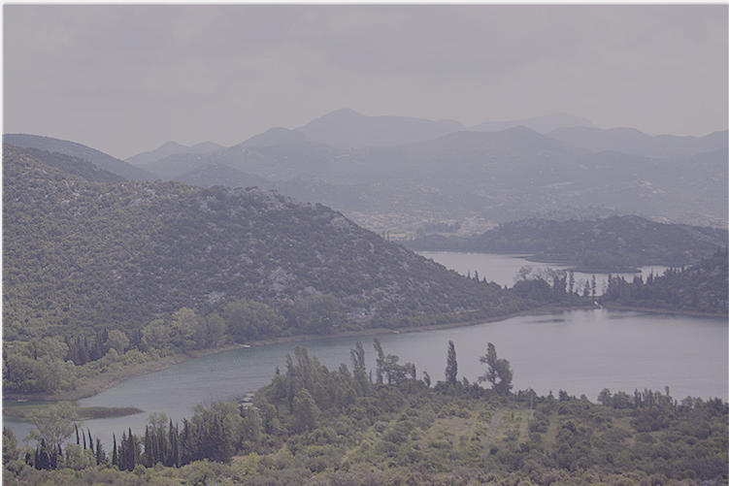
Outputs:
Original: Single Scale Retinex:

Slide 6
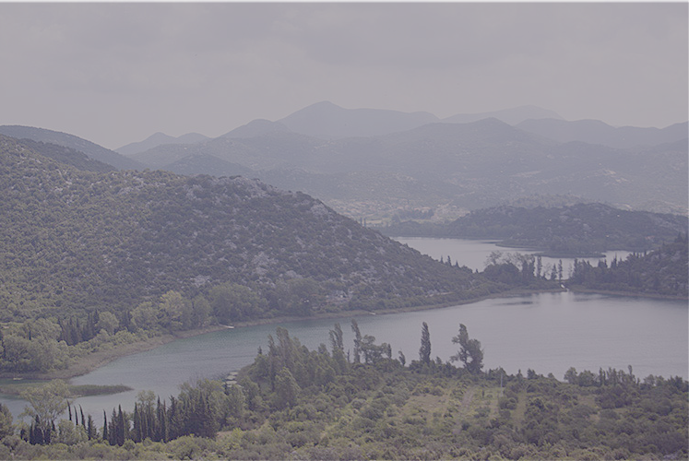
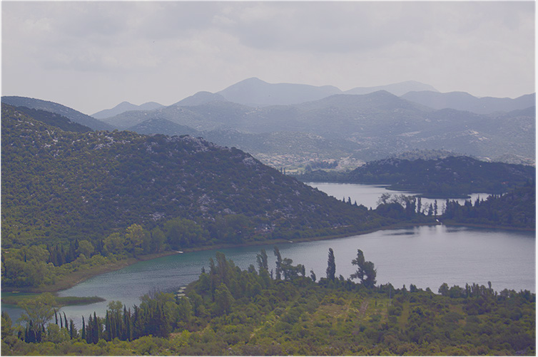
Multiscale Retinex: Multiscale retinex with color restoration:

Slide 7
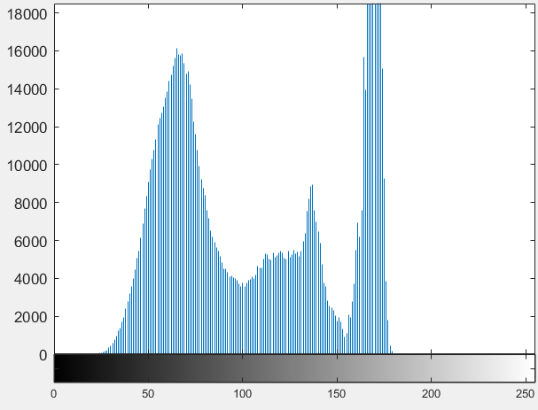
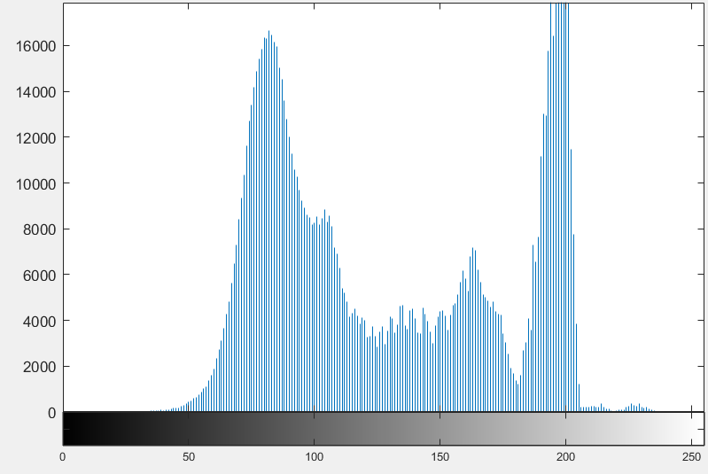
Histogram:
Original Multiscale retinex with color restoration:

Slide 8
Conclusion :
A novel method for color image enhancement using multiscale retinex with modified color restoration technique in RGB color space was presented. In this method, operation steps are organized in a systematic way so that their effects can be seen clearly. In addition, it adds true color constancy for an image. The proposed image enhancement method constitutes a successful enhancement of color images since the method improves the luminance of an image without sacrificing the contrast of an image.
The image quality obtained using this approach was far better compared to standard existing methods. Currently, work is under progress for amending the algorithm for aerial images, medical images etc.

